Slide 1
Airbnb in New York City - Impact of Neighborhoods An Exploratory Data Analysis Project
KUMARDIPTA SARKAR
14.06.2021

Slide 2
the Listings on Airbnb – an analysis
Airbnb – an online marketplace for accommodations, lodgings and home-stays
The price and popularity of the listings depends on various parameters
Nearby venues or neighborhood can be an important determining factor
Understanding these patterns may help to guide marketing initiatives or may help to implement innovations

Slide 3
the Data – cleaning and wrangling
Dataset – New York City Airbnb Open Data on Kaggle
In total, 48,895 rows and 16 columns present in the raw dataset
Processing the null values – by removing and replacing
Dropping features not required for analysis
Foursquare API to be used for geolocation service
Final dataset has 31,358 rows and 11 columns

Slide 4
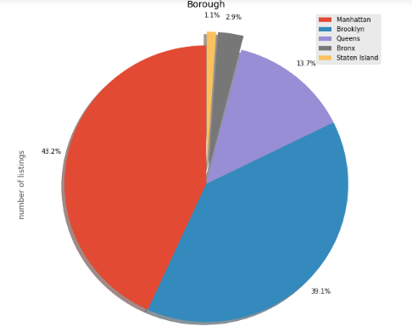
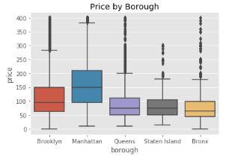
Boroughs
Manhattan followed by Brooklyn – areas with most listing and higher median price

Slide 5
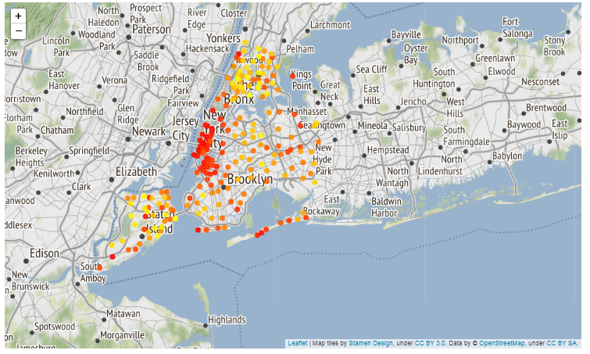
Neighborhoods
Neighborhoods in Manhattan have higher average price than neighborhoods in Bronx or Staten Islands

Slide 6
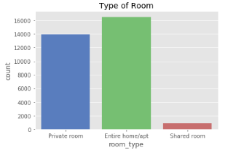
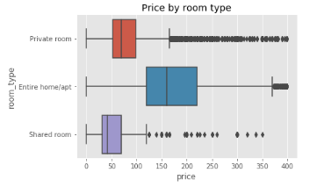
Room type
Shared rooms are least popular
Entire Homes/Apartments are the most expensive

Slide 7
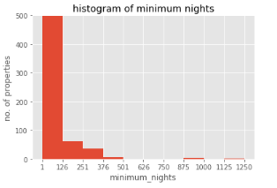
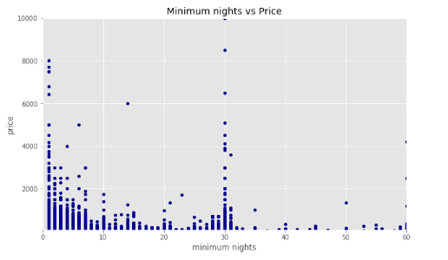
Minimum nights
Most properties can be booked for minimum of 1-126 nights

Slide 8
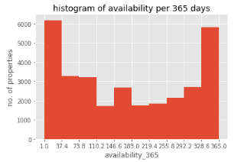
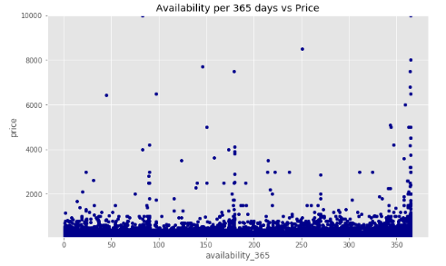
Availability 365
Most properties available for either throughout the year or for a very limited time – a day or a week

Slide 9
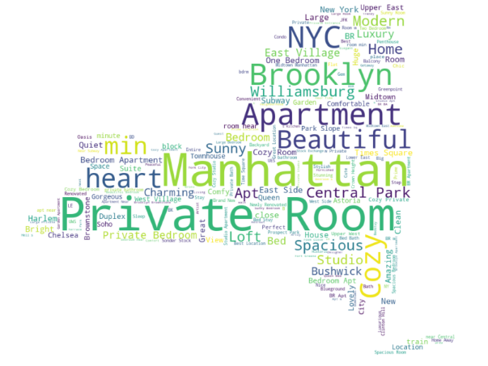
Names
PRIVATE ROOMS in MANHATTAN - the most common listing

Slide 10
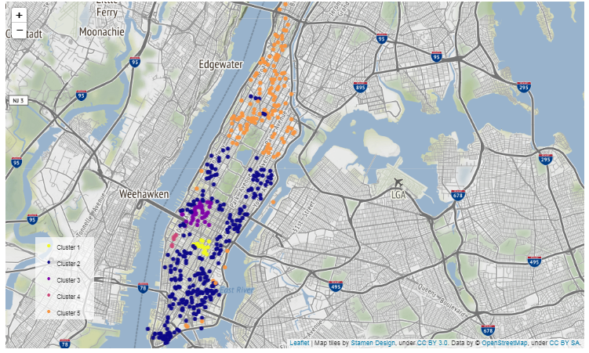
Kmeans Clustering
The 5 clusters of Manhattan – basis nearby venues

Slide 11
Conclusion & future scope
Private Rooms in Manhattan – most popular listings
Manhattan and Brooklyn have the most number of listings and the highest prices for the properties
Shared rooms are least favored and entire homes/apartments are more expensive
The locality of Manhattan distributed into 5 clusters show distinct traits, popularities and price ranges
Future scope – These parameters can be used for predictive modelling – for predicting prices of the listings basis the features

